Slide 1

Protection of Minor Training
BYU–Hawaii
Protection of Minor Training

Slide 2
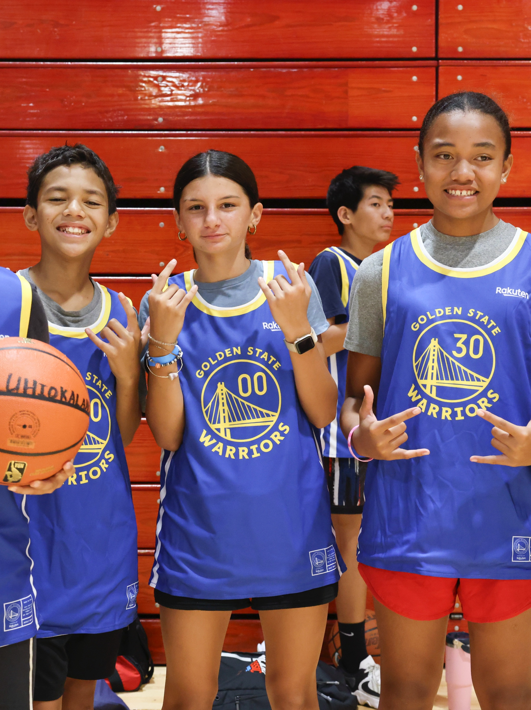
Commitment
Brigham Young University Hawaii is committed to providing a safe environment for minors
BYU–Hawaii, The Church of Jesus Christ of Latter-day-Saints, the Church Educational System Honor Code, as well as state and federal laws and regulations, are united in efforts to protect minors on campus that participate in BYU–Hawaii sponsored activities or use university facilities, from abuse.
These minors may include, but are not limited to, family members of faculty, staff, and student families, or visitors at BYU–Hawaii.

Slide 3
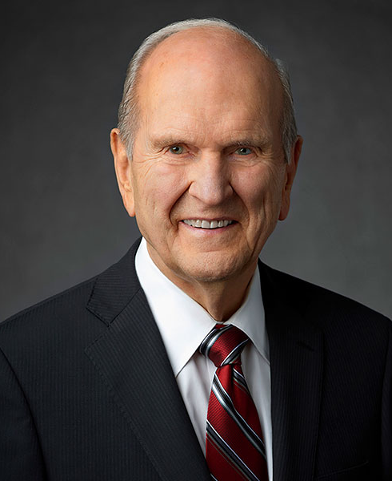
President Nelson Quote
“Abuse constitutes the influence of the adversary. It is a grievous sin. As President of the Church, I affirm the teachings of the Lord Jesus Christ on this issue. Let me be perfectly clear: any kind of abuse of women, children, or anyone is an abomination to the Lord. He grieves and I grieve whenever anyone is harmed. He mourns and we all mourn for each person who has fallen victim to abuse of any kind. Those who perpetrate these hideous acts are not only accountable to the laws of man but will also face the wrath of Almighty God. . . .

Slide 4
President Nelson Quote
. . . For decades now, the Church has taken extensive measures to protect—in particular—children from abuse. I urge each of us to be alert to anyone who might be in danger of being abused and to act promptly to protect them. The Savior will not tolerate abuse and as his disciples, neither can we.”
Russell M Nelson

Slide 5
Abuse violates laws of society
Abuse violates the laws of society and the laws of God. The Lord expects us to do all we can to prevent abuse and to protect and help those who have been victims of abuse. No one in the BYU–Hawaii community shall be involved in any form of child abuse on and off campus and must make best efforts to report any known or suspected abuse of minors to appropriate authorities.
This training is designed to educate adults working with minors of their legal duty to report abuse and of the appropriate standards of conduct and safety while working with minors. To that end, no faculty member, staff employee, administrative employee, contractor, volunteer, or student shall be involved in the abuse or neglect of a minor, whether on or off campus.
This training will emphasize the BYU–Hawaii Minor Protection Policy and will include eight main sections:
              Definitions
              Duty to Report
              Authorized Adults Requirements
              Standards of Conduct for Authorized Adults
              Additional Guidelines
              Non-University Programs
              Investigations
              Sanctions

Slide 6
Definitions
Definitions
Abuse:
  Abuse is neglect or mistreatment of a minor in a way that causes, or could cause physical, emotional, or sexual harm.
  Abuse includes sexual abuse and sexual exploitation as defined later.
  Abuse does not include reasonable discipline of management of a minor, including withholding privileges, or the use of reasonable and necessary physical restraint or force on a minor to protect the minor or others from harm.
Adult: a person, 18 years of age or older.
Authorized Adult: an adult paid or unpaid, who meets all the requirements listed in this policy necessary to qualify to have direct interaction with minors in a university program or non-university program (e.g., criminal-charge disclosure, background check, and training).
Background Check
  Background checks are governed by the Background Check and Criminal Charge Disclosure policy found here https://policies.byuh.edu/background-check
Minor: any person under the age of 18 years

Slide 7
Definitions
Non-University Program:
  A non-university program means an organized program, activity, or event that
    Includes participants or volunteers who are minors.
    Is offered, sponsored, and operated entirely by an organization or individual NOT acting under the direction or control of the university or the Church of Jesus Christ of Latter-day Saints; and
    Is held on campus or otherwise uses university-owned facilities.
The following are excluded from the definition of Non-University Programs:
    Authorized Educational Visits:
    Programs, activities, events, and services open to the general public where attendance and supervision of Minors is at the sole discretion and responsibility of parents or guardians; and
    Programs, activities, events, and services not open to the general public where parents or guardians are required to accompany their Minors.
One-on-one: One-on-one interaction is individual interaction, whether in person or through electronic communication or other means, between an adult and a minor in a manner that is not clearly visible to another adult in the immediate vicinity.
Program Director: Program director means an authorized adult, at least 21 years of age, who has primary responsibility for overseeing a university program, non-university program, or authorized educational visit. A program director serves as the primary point of contact for a university program, Non-university program, or authorized educational visit and is also responsible for ensuring compliance with the requirements of this policy.

Slide 8
Definitions co
Parent or Guardian: the legal parent of legal guardian of a minor.
Sexual Abuse
  Sexual abuse is any sexual activity between a minor and an adult.
  Sexual abuse can also include sexual conduct between a minor and another minor especially when one of them is older or is in a position of power, trust, or control.
  Sexual abuse also includes the viewing, creation and distribution of child pornography.
Sexual Exploitation
  Sexual exploitation includes knowingly using or influencing a minor to engage in sexual activity, including viewing pornography, for the sexual arousal of an Adult or for the purpose of photographing or recording the activity.
  Sexual exploitation also includes displaying, distributing, selling, or possessing child pornography.
  A minor is abused or exploited through any of the described actions whether the activity involves explicit force, involves physical contact, is initiated by the minor, or produces a discernible harmful outcome.
University Program
A university program is an organized program, activity, or event that includes participants or volunteers, who are minors and is offered, sponsored, or operated by an organizational unit of BYU–Hawaii. University programs may occur on or off campus. The following are excluded from the definition of University Program:
  Authorized Educational Visits
  Programs, activities, and events intended for undergraduate students, even if they involve Minors who are admitted undergraduate or registered for undergraduate courses (e.g., 17-year-old freshmen and high school students concurrently enrolled in BYU–Hawaii courses);

Slide 9
Definitions contiued
  Programs, activities, events, and services open to the general public where attendance and supervision of Minors is at the sole discretion and responsibility of parents or guardians (e.g., performances, lectures, dining facilities, BYUH Store);
  Programs, activities, events, and services not open to the general public where parents or guardians are required to accompany their Minors;
  Programs, activities, and events designed for Adults, even if a person under 18 may participate;
  Patient-care related activities of Health Services subject to separate Minor protection procedures;
  Off-campus academic or volunteer opportunities with non-BYU organizations that the university helps arrange for students, provided the non-BYU organization is solely responsible for protecting Minors (e.g., internships, student-teaching, volunteer opportunities);
  Research protocols involving Minors as human subjects, which are subject to requirements specified by BYU–Hawaii’s Institutional Review Board;
  Visits to campus by youth groups sponsored by the Church of Jesus Christ, including FSY sessions, where the group’s Adult leaders are responsible for supervising the Minors involved; and
  Employment of a Minor by the university.
There is ZERO tolerance for abuse.
BYU–Hawaii personnel, volunteers, contractors, and students must not engage in any form of abuse, as previously defined whether on or off campus, and should do all they can to prevent it and to protect and help those who have been victims of abuse.

Slide 10
Duty to Report
Duty to Report
The university is committed to maintaining a safe environment for all minors on campus who are participating in university-sponsored activities.
In accordance with Hawaii State law, the BYU–Hawaii Minor Protection Policy states all BYU–Hawaii personnel, volunteers, contractors, and students are mandated reporters
  and have a legal duty to immediately report to the Honolulu Police Department ((808) 723-8650) or the State of Hawaii Department of Human Services ((808) 832-5300) any situation, whether on or off campus, in which they “have reason to believe that Child Abuse or Neglect has occurred or that there exists a substantial risk that Child Abuse or Neglect may occur in the reasonably foreseeable future.”
  Reporters must also immediately notify a member of the President’s Council.
  and must follow up with a written report to the State of Hawaii Department of Human Services.
For questions about this reporting obligation, including how to make a report, please call BYU–Hawaii’s University Scheduling department ((808) 675-3780, Office of Compliance and Ethics ((808) 675-3368), or Office of General Counsel ((801) 422-3089). In case of immediate threat of violence, call the police, 911.
Incidents of Sexual Abuse or Sexual Exploitation of a minor on campus or in any university program should also be reported to the BYU–Hawaii’s Title IX coordinator, who should ensure that university policies and procedures for investigating such complaints are followed and, if appropriate, disciplinary procedures are initiated.

Slide 11
Duty to Report continued
BYU–Hawaii personnel, volunteers, contractors, and students who have knowledge of and fail to report or to cooperate in the investigation of complaints of abuse may be subject to appropriate disciplinary action, up to and including termination of employment and dismissal from the university. In these situations, BYU–Hawaii will seek to preserve the confidentiality of the reporting party, provided that it does not interfere with BYU–Hawaii’s ability to investigate and take corrective action and is not prohibited by law.
Abuse will be considered a violation of policy, and the retaliating person may be subject to sanction, including termination, suspension, dismissal, and/or a ban from campus, depending on the circumstances and severity of the retaliation. Encouraging others to retaliate also violates this policy.
A person does not need tangible proof of Abuse to have a duty to report under Hawaii law; a duty arises when one has a reason to believe abuse has occurred or when there exists a substantial risk that abuse may occur in the reasonably foreseeable future.
BYU–Hawaii discourages the presence of unescorted or unsupervised minors on campus. An employee, volunteer, contractor, or student who brings a minor-aged relative, friend, or other guest on campus, including in campus facilities, is responsible for supervising the minor at all times.

Slide 12
Authorized Adults Requirements
Authorized Adults Requirements
Only Authorized Adults may have Direct Interaction with Minors in a University Program or Non-University Program.
The following requirements and standards apply to Authorized Adults.
Background Checks:
  To protect Minors, the university will conduct background checks to the extent required by law.
Training:
  All university personnel, including faculty, staff, administrative employees, volunteers, contracted personnel, and students, shall be notified of their obligation to report suspected Abuse under Hawaii law.
  University faculty, staff, administrative employees, volunteers, contracted personnel, and student employees participating in University Programs involving Minors must complete training on Abuse prevention and reporting prior to working with Minors and annually thereafter.
  All university employees working with Minors shall review and sign the university’s Youth Protection Policy Statement of Acknowledgement indicating they will comply with the university’s policies and standards and have completed the required youth protection training.
Authorized Adult Standards:
  Authorized Adults interact with Minors in accordance with the Standards of Conduct.
One-on-One Interaction:
  Authorized Adults should avoid One-on-One Interaction. Where avoiding One-on-One Interaction is not feasible, the Authorized Adult should take reasonable precautions to eliminate the risk of improper contact—e.g., providing a well-illuminated, easily accessible space or room observable by other Adults, and providing prior written notification to the Authorized Adult’s supervisor and the parent or guardian. One-on-One Interaction may be necessary in emergency situations.

Slide 13
Standards of Conduct for Authorized Adults
Standards of Conduct for Authorized Adults
University-sponsored programs involving minors should provide adequate supervision not only during scheduled activity time, but also during free time. The degree of supervision and limitations placed on the minor participants should be commensurate with their age, maturity, discretion and other relevant circumstances.
Authorized adults involved in university programs must comply with the CES Honor Code.
Authorized adults in both university programs and non-university programs must not engage in any of the following:
    Abuse, hazing, or bullying in any form, whether by means of direct physical contact, verbal communications, text messages, email, online forums, social networking sites, or any other method.
    Strike, hitting, administering corporal punishment to, or touch a minor in an abusive or illegal manner.
    Sleeping in the same room, tent, or other same-space dwelling as a minor, unless the minor is the authorized adult’s son, daughter, or sibling.
    Assist minors in accessing pornography or make any form of pornography available to them.
    Being along with a minor in a bathroom, changing area, showering area, or locker room except when responding to a specific emergency.
    Dressing, showering, or bathing in the presence of a minor, unless it is part of a pre- or post-activity rinse where appropriate swimwear is worn at all times.

Slide 14
Standards of Conduct for Authorized Adults continued
    Transporting a minor in a personal vehicle unless the minor is a close relative of the authorized adult.
    Dating a minor, asking a minor to keep secrets, or inviting a minor to the authorized adult’s home.
    Consuming, possessing, providing, or displaying tobacco, alcohol, illegal substances, or prescription drugs (unless a parent or guardian has specifically authorized in writing the administration of prescription drugs.
    Carrying, using, providing, or displaying firearms or weapons of any kind (unless done in connection with a legitimate activity of the program and specifically authorized by Safety & Risk Management).

Slide 15
Additional Guidelines
Additional Guidelines
The organizational unit offering, sponsoring, or operating a University Program is solely responsible for complying with this policy and for any associated expenses.
Prior to operation, a university program must do the following:
  Formally appoint a program director, who is responsible for compliance with this policy.
  Document the name of each Authorized Adult, verifying that each meets the criminal-charge disclosure, Background Check, and training requirements of this policy prior to the Authorized Adult’s involvement in the University Program.
  Obtain for each Minor a participation agreement signed by the Minor’s parent or guardian, which may include these provisions:
    Parent or guardian consent for the Minor to participate.
    Commitment from the Minor and parent or guardian to comply with applicable university rules and policies.
    Description of the activities and an assumption of risks.
    Waiver of liability in favor of BYU–Hawaii.
    Authorization for emergency medical treatment if parents or guardians are unavailable;
    Disclosure of any allergies or other medical or physical condition that might impact participation; and image consent.
  Take reasonable measures to inform Minors and their parents or guardians of the BYU–Hawaii Privacy Notice.
  Arrange access to emergency medical services and licensed emergency medical transport at all locations during the University Program.

Slide 16
Additional Guidelines continued
  Establish a procedure for notifying parents or guardians in the event of an emergency and obtain and keep accessible contact information for parents/guardians, as well as emergency contacts in case parents or guardians are unavailable.
  Provide information to parents or guardians detailing the manner in which their minors may be contacted during the University Program.
  Establish an age-appropriate procedure for the drop-off and pick-up of Minors at the beginning and end of the university program, as well as check-out procedures during the University Program.
During operation, a University Program must
  Establish a supervision structure for authorized adults overseen by the program director.
  Ensure that only authorized adults have direct Interaction with minors in university programs.
  Provide an adequate supervision ratio of minors to authorized adults, taking into account the number and age of the minors, the activities involved, the type of facilities used, and the age and experience of authorized adults; at a minimum there must be two authorized adults providing supervision over a university program.
  When a minor is taken to a medical facility, provide reasonable supervision given the policies and protocols of the medical facility and in collaboration with parents or guardians.
  Limit transportation of minors to university vehicles driven by authorized adults who have completed applicable training required by the university, with usage of age-appropriate safety restraints.
  When changing or showering is required, provide minors with access to changing areas and shower stalls with reasonable privacy.
  where possible, minimize changing area, shower, or locker room use by participants when adults who are not authorized adults are present, and avoid allowing different-aged youth to change or shower at the same time.
  comply with procedures applicable to university programs with online activities.

Slide 17
Non-University Programs
Non-University Programs
A non-university program wishing to operate on campus or otherwise use university facilities must first enter into a written agreement approved by Safety & Risk Management requiring the non-university programs to do the following:
  Formally appoint a program director;
  Secure the approval of an organizational unit of the university;
  Document that each authorized adult meets the criminal-charge disclosure, background check, and training requirements of this policy and provide such documentation to BYU–Hawaii upon request;
  Provide an age-appropriate supervision ratio.
  Adequately supervise authorized adults, taking reasonable measures to ensure compliance with and enforcement of the standards of conduct set forth in this policy applicable to non-university programs.
  Obtain for each minor, and provide to the university upon request, an agreement approved by Safety & Risk Management and signed by the minor’s parent or guardian covering at least the following:
      parent or guardian consent for the minor to participate;
      description of the activities and an assumption of risks; and
      waiver of liability in favor of BYU–Hawaii;
  Indemnify the university for any claims arising from the non-university program; and
  Obtain and maintain insurance coverage.

Slide 18
Investigations and Sanctions
Investigations
Investigations of alleged or suspected Abuse are the responsibility of either the Hawaii Department of Human Services or the Honolulu Police Department. On-campus coordination will be provided by the university’s Campus Safety & Security.
Sanctions
In accordance with other university policies regarding personnel discipline, any university faculty member, staff employee, administrative employee, or contracted personnel convicted of abuse will be terminated, regardless of whether the abuse occurred on or off campus. In accordance with other university policies regarding student discipline, including but not limited to the CES Honor Code, any student convicted of abuse will be dismissed from the university, regardless of whether the abuse occurred on or off campus.
If there is a reasonable basis, as determined by the university, to believe that a university faculty member, staff employee, administrative employee, contracted personnel, or student has engaged in abuse, on or off campus, then the faculty member, staff employee, administrative employee, contracted personnel, or student is subject to university discipline in accordance with university policy, up to and including termination or dismissal from the university. (See also Sex Discrimination policy)

Slide 19

Closing and Questions
Closing
This training is meant to provide a functional understanding of university policies and guidelines regarding the protection of minors.
Questions
University Scheduling
(808) 675-3780
universityscheduling@byuh.edu
scheduling.byuh.edu/protection-of-minors

Slide 20
Mahalo
Mahalo
Thank you for completing this training and, as part of the BYU–Hawaii community, thank you for your commitment to promote a safe environment for minors.
As a final step of this training, please complete the Protection of Minors Acknowledgement and Agreement found here:
scheduling.byuh.edu/protection-of-minors-acknowledgement

